Slide 1
Geo-Temporal Analysis on Salt Lake city traffic
Statistics for High Dimensional Data (S4HDD) and CompStat Lab a.a. 2023/2024 (2nd edition)
Silviu Filote - 1059252 Jonathan Bommarito - 1068755
DATA
Febbraio 2024

Slide 2
Outline
Introduction
Dataset description and enrichment
Research Focus and Methodology Overview
DCM modeling
Seasonality management in DCM models
HDCM modeling
Conclusion
Further research

Slide 3
Introduction

Slide 4
Nowadays, traffic congestion represents one of the most common and persistent challenges afflicting urban environments worldwide. The main reason could be public transports and mobility in most parts of the world are not really developed, also the infrastructure and technology required in order to improve the transportation system seems to be really complex and expensive. Furthermore, the necessity of relying on private or personal vehicles for mobility amplify the traffic congestion. The analysis of this research aims to apply geo-temporal models and examine how they perform on the Salt Lake City traffic recorded by stations placed around the city, taking care of understanding which are the main factors that plague the traffic congestion.

Slide 5
Dataset description and enrichment

Slide 6
Dataset description
Selected dataset is called “Salt Lake City Traffic” and it’s available on Kaggle
The original dataset is divided into 2 parts
"Utah Traffic": Hourly traffic observations for 50 stations from January 1, 2022, 00:00, to January 31, 2022, 23:00. Missing data identified as NaN values.
"Utah Traffic MetaData": Contains latitude, longitude information for each station, and the route name.
Enriching the dataset due to lack of usable variables as covariates.

Slide 7
Dataset enrichment
Initial dataset: Covariate limited to station route names
Introduction of additional dummy variables:
"Weekend": Indicates Saturday or Sunday (1 if true, 0 otherwise).
"Holidays": Identifies significant holidays in the month.
"Traffic on": Reflects peak traffic hours (1 between 7 AM and 5 PM, 0 otherwise).
"Hours": Helps explain seasonality.
Classification of stations based on route names and integration as dummy variables:
"Interstate": High-speed roads across multiple states.
"US": U.S. Route national highways connecting cities and regions.
"RS": State Route roads linking rural areas, cities, and locales within a state.
Precipitation and Temperature Enrichment at all spatial locations via open-meteo.com API as temporal covariates, due to low spatial dependency:
“mean prec": mean of the precipitations
“mean temp": mean of the temperature

Slide 8
Research focus and methodology overview

Slide 9
Overview
Objective: examine Salt Lake City traffic as a response variable using DCM and HDGM models along with enrichment the covariates
Model Performance Evaluation:
residuals Analysis
validation phase using a clustering method and evalutation of the validation statistics
Log-likelihood Model's Parameter
Tuning Approaches:
Maximization of log-likelihood function
EM convergence based on randomization of initial parameters

Slide 10
DCM modeling

Slide 11
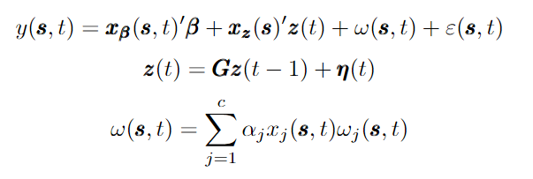
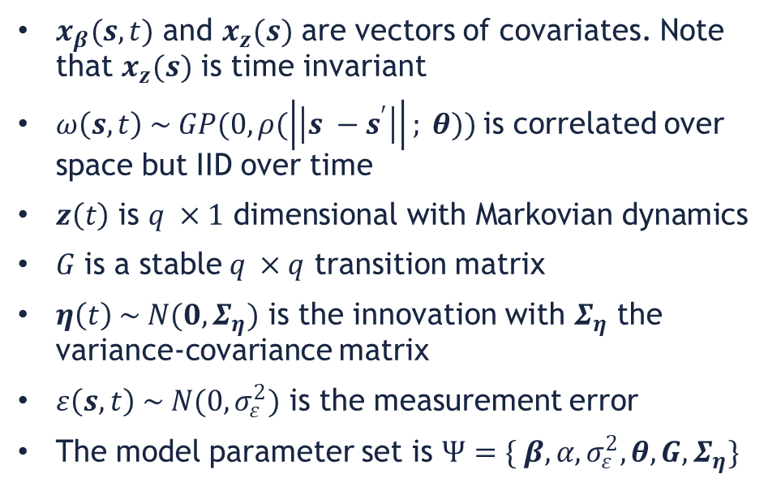
The DCM
$x_{β}(s,t)$ and $x_{z}(s)$ are vectors of covariates. Note that $x_{z}(s)$ is time invariant
$ω\left(s,t\right) \sim GP(0, ρ(\left|\left|s −s^{′}\right|\right|; θ))$is correlated over space but IID over time
$z\left(t\right)$ is $q ×1 \text{dimensional} \text{with} \text{Markovian} \text{dynamics}$
$G \text{is} \text{a} \text{stable} q ×q$ transition matrix
$η\left(t\right) \sim N(0,Σ_{η})$ is the innovation with $Σ_{η}$ the variance-covariance matrix
$ε\left(s,t\right) \sim N(0, σ_{ε}^{2})$ is the measurement error
The model parameter set is $Ψ=\{ β, α,σ_{ε}^{2},θ, G,Σ_{η}\}$

Slide 12
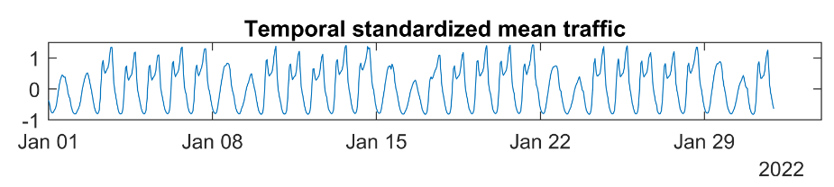
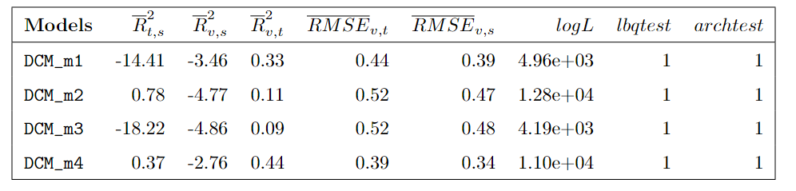
DCM parametrizations
Objective: explore various parameterizations of the response variable using DCM for optimal performance selection.
All the models analyzed have the same initial parametrization
Based on the training and validation statistics the DCM_m4 seems to be a good overall model
Figure 1: Temporal mean of the standardized traffic
Table 1: Most performant models built using a DCM modelization with the same initial parametrization. For each model validation and training parameters are reported along with the log-likelihood parameter as well as the test conducted on the residuals.

Slide 13
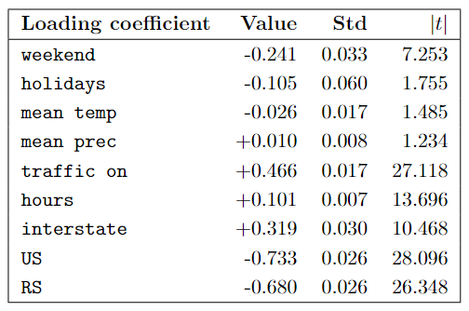
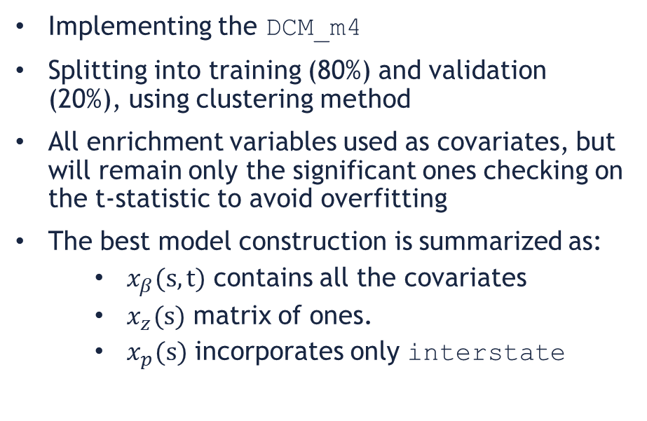
DCM implementation
Implementing the DCM_m4
Splitting into training (80%) and validation (20%), using clustering method
All enrichment variables used as covariates, but will remain only the significant ones checking on the t-statistic to avoid overfitting
The best model construction is summarized as:
$x_{β}(s,t)$ contains all the covariates
$x_{z}(s)$ matrix of ones.
$x_{p}(s)$ incorporates only interstate
Table 2: All covariates included in the fixed effect part of the DCM_m4 model

Slide 14
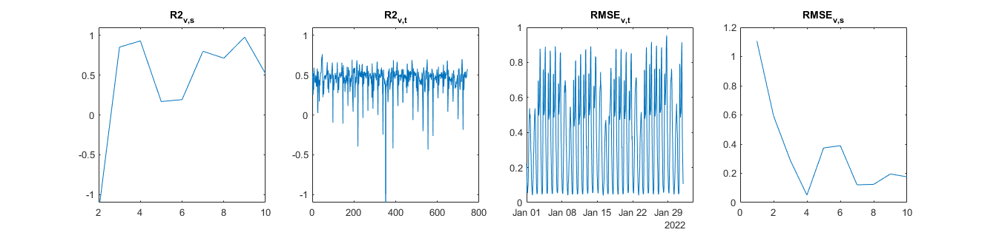
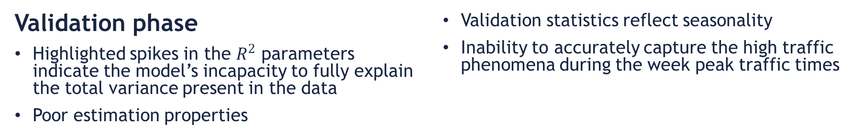
Validation phase
Highlighted spikes in the $R^{2}$ parameters indicate the model’s incapacity to fully explain the total variance present in the data
Poor estimation properties
Validation statistics reflect seasonality
Inability to accurately capture the high traffic phenomena during the week peak traffic times
Figure 2: Temporal and spatial validation statics of the DCM_m4 model. The spikes defined as peaks surpassing the imposed y-axis limit

Slide 15
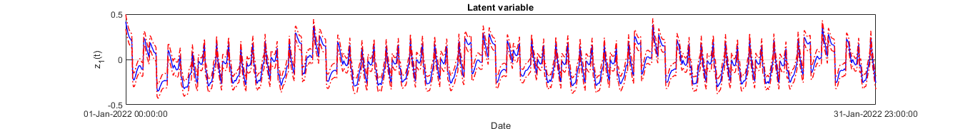
Latent variable
The latent variable as temporal correction over the fixed effect
Significant behaviour over time
Seasonal pattern expected based on the traffic distribution
Enrichment covariates as well as latent variable not enough to mitigate the seasonal component
Figure 3: Latent variable estimated by the DCM_m4 model

Slide 16
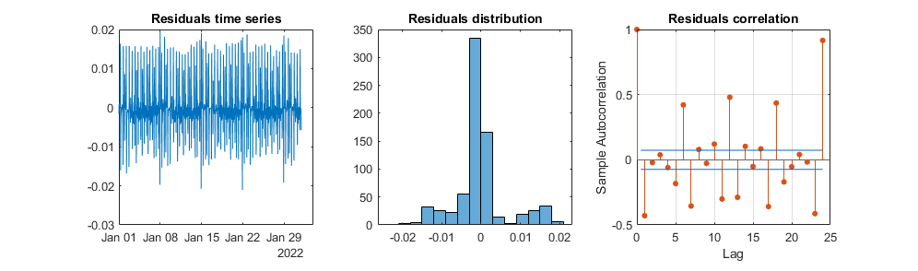
Residual analysis
lbqtest confirms eteroskedastic behavior
Archtest confirms correlation over the 24-hour period
Dubious residual distribution
Evident seasonal pattern remaining within the residuals
DCM_m4 fails to capture all the variability present in the initial data, as evidenced by the residual attitude
Model assumptions aren’t met
Figure 4: Temporal mean residual statistics derived from the training phase of the DCM_m4 model. During the training phase 80% of the available data is used, which includes 40 stations out of 50

Slide 17
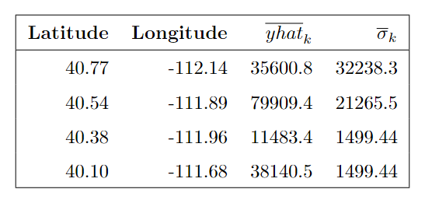
Kriging results
Evaluate the predictive capacity of the DCM_m4 model
Predict the traffic in 4 specific locations
These locations coordinates were selected in proximity to our existing traffic network
At these spatial locations choose by us we also added the enrichment covariates
Really high kriging uncertainty compared to the mean traffic estimated
Table 3: Mean spatial estimates and uncertainty of the kriging locations. The locations are listed starting from the top to the bottom of the figure 6

Slide 18
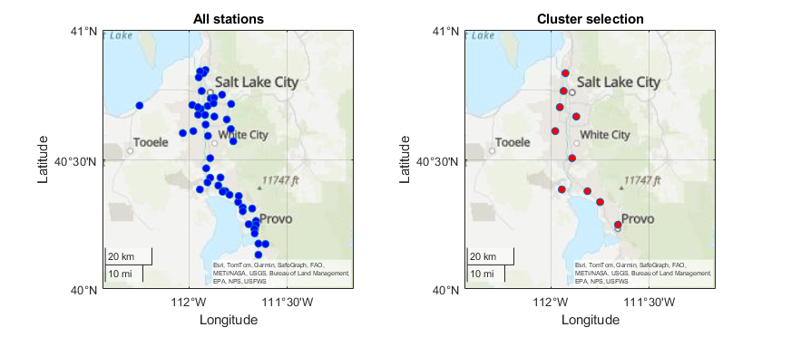
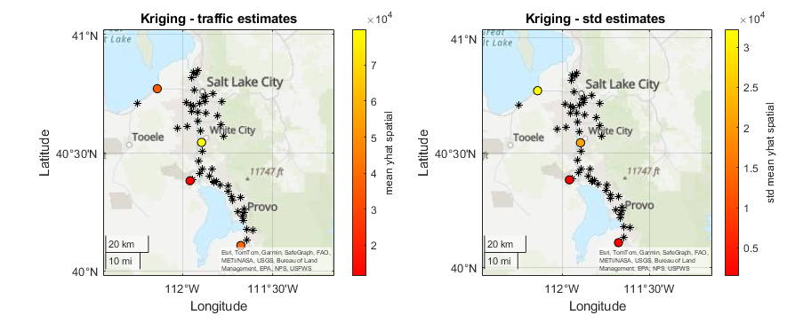
Figure 5: (Left) All the stations included in our dataset. (Right) Clustering technique applied on the 50 stations. The validation performances of these stations using this technique are listed in table 1
Figure 6: Kriging estimates are represented by the marked dots at specific spatial locations, while the black markers denote all the traffic stations included in the dataset

Slide 19
Seasonality management in DCM models

Slide 20
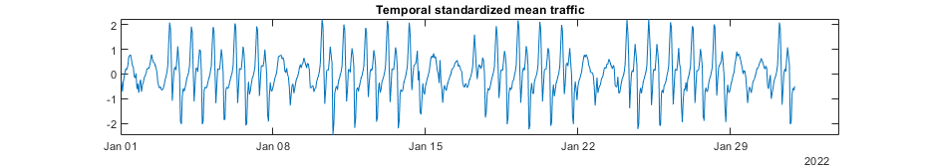
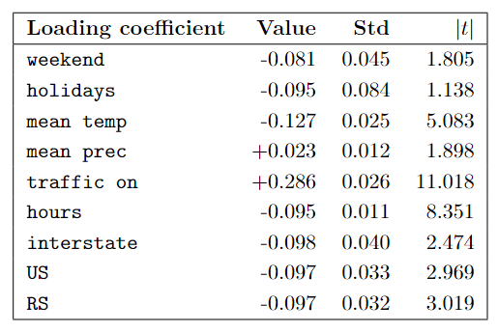
Differencing method
From the time series literature one way to treat seasonality is by differencing or seasonal differencing
Both methods can help to reduce or eliminate the seasonality trend in the data
Objective: apply the differencing method to our response variable and see the results
We will create the DCM_m4_seas which have the same implementation structure as DCM_m4
Figure 7: Temporal mean of the standardized traffic, computed after applying the differencing method to the response variable
Table 4: All β coefficients of the covariates included DCM_m4_seas model

Slide 21
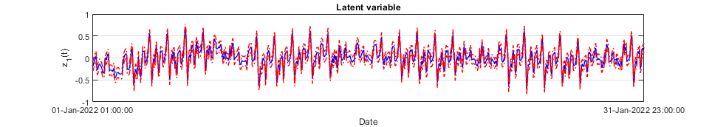
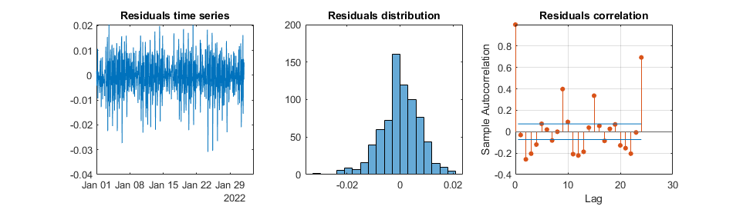
Results
The latent variable has the same form as the response variable
Different temporal adjustment
Latent variable is capturing a different phenomenon
Residual distribution and correlation is better from before
Differencing approach improved residual behaviour and overall statistics
Figure 8: Latent variable estimated by the DCM_m4_seas model
Figure 9: Mean temporal residuals statistics estimated from the DCM_m4_seas model in training phase

Slide 22
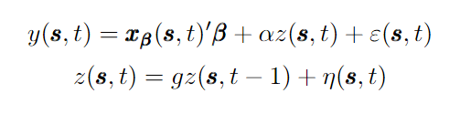
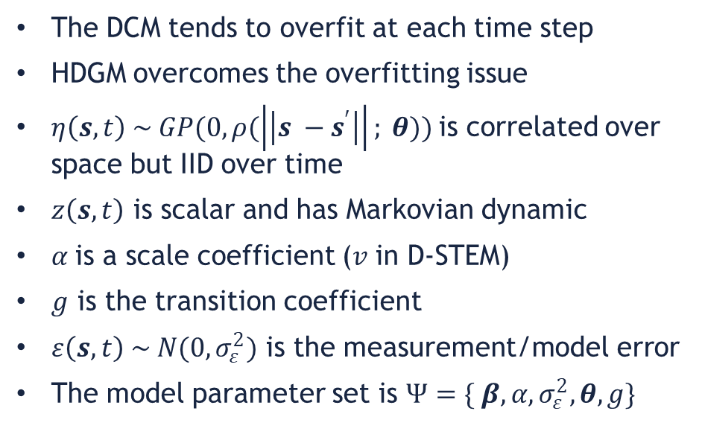
The HDGM
The DCM tends to overfit at each time step
HDGM overcomes the overfitting issue
$η\left(s,t\right) \sim GP(0, ρ(\left|\left|s −s^{′}\right|\right|; θ))$is correlated over space but IID over time
$z\left(s,t\right)$ is scalar and has Markovian dynamic
$α$is a scale coefficient (𝑣 in D-STEM)
$g$ is the transition coefficient
$ε\left(s,t\right) \sim N(0, σ_{ε}^{2})$ is the measurement/model error
The model parameter set is $Ψ=\{ β, α,σ_{ε}^{2},θ, g\}$

Slide 23
HDCM modeling

Slide 24
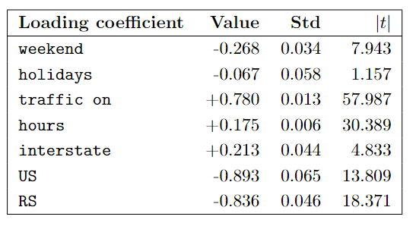
HDGM implementation
Table 5: All β coefficients of the covariates included in the fixed effect part of the HDGM.
Only the significative covariates are kept into the model to avoid overfitting. mean temp,
As well as mean prec covariates are not significant so they were removed.
DCM you tend to overfit, because of no constraints on the spatially varying effects
This lack of constraints is overcome with the HDGM with a more structured approach
HDGM has same structure as the DCM_m4:
100 EM iterations
Splitting into training and validation dataset
Passing all the covariates to the fixed effect component and a matrix of ones to the latent variable
Only significant covariates are kept into the model: no overfitting, better generalization

Slide 25
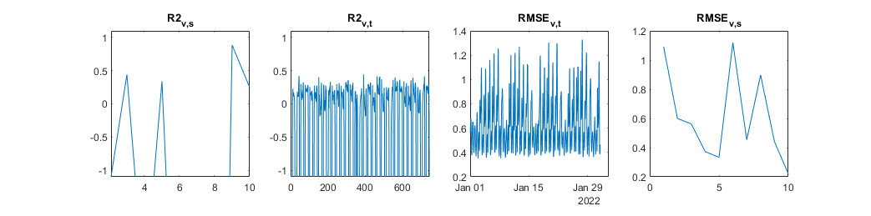
Validation phase
Highlighted spikes in the validation statistics indicate the model’s incapacity to fully explain the total variance present in the data
Poor estimation properties and inadequate generalization
Sesonality pattern still present in the statistics
Inability to accurately capture the high traffic phenomena during the week peak traffic times
Figure 10: Temporal and spatial validation statics of the HDGM model. The spikes defined as peaks surpassing the imposed y-axis limit.

Slide 26
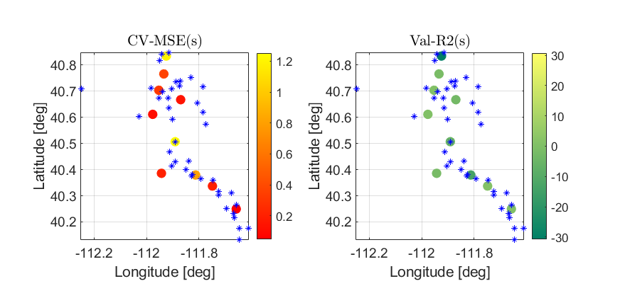
Validation dynamics on the territory
Clustering method
Training stations cover uniformly the entire area
Validation stations trategically selected within the region
Reduce uncertancy and increse estimates consistency
Poor overall predictions by HDGM model
Figure 11: Validation statistics displayed spatially on the Salt Lake territory. (Blue markers) are the training stations instead the (Highlighted dots) are the validation stations.

Slide 27
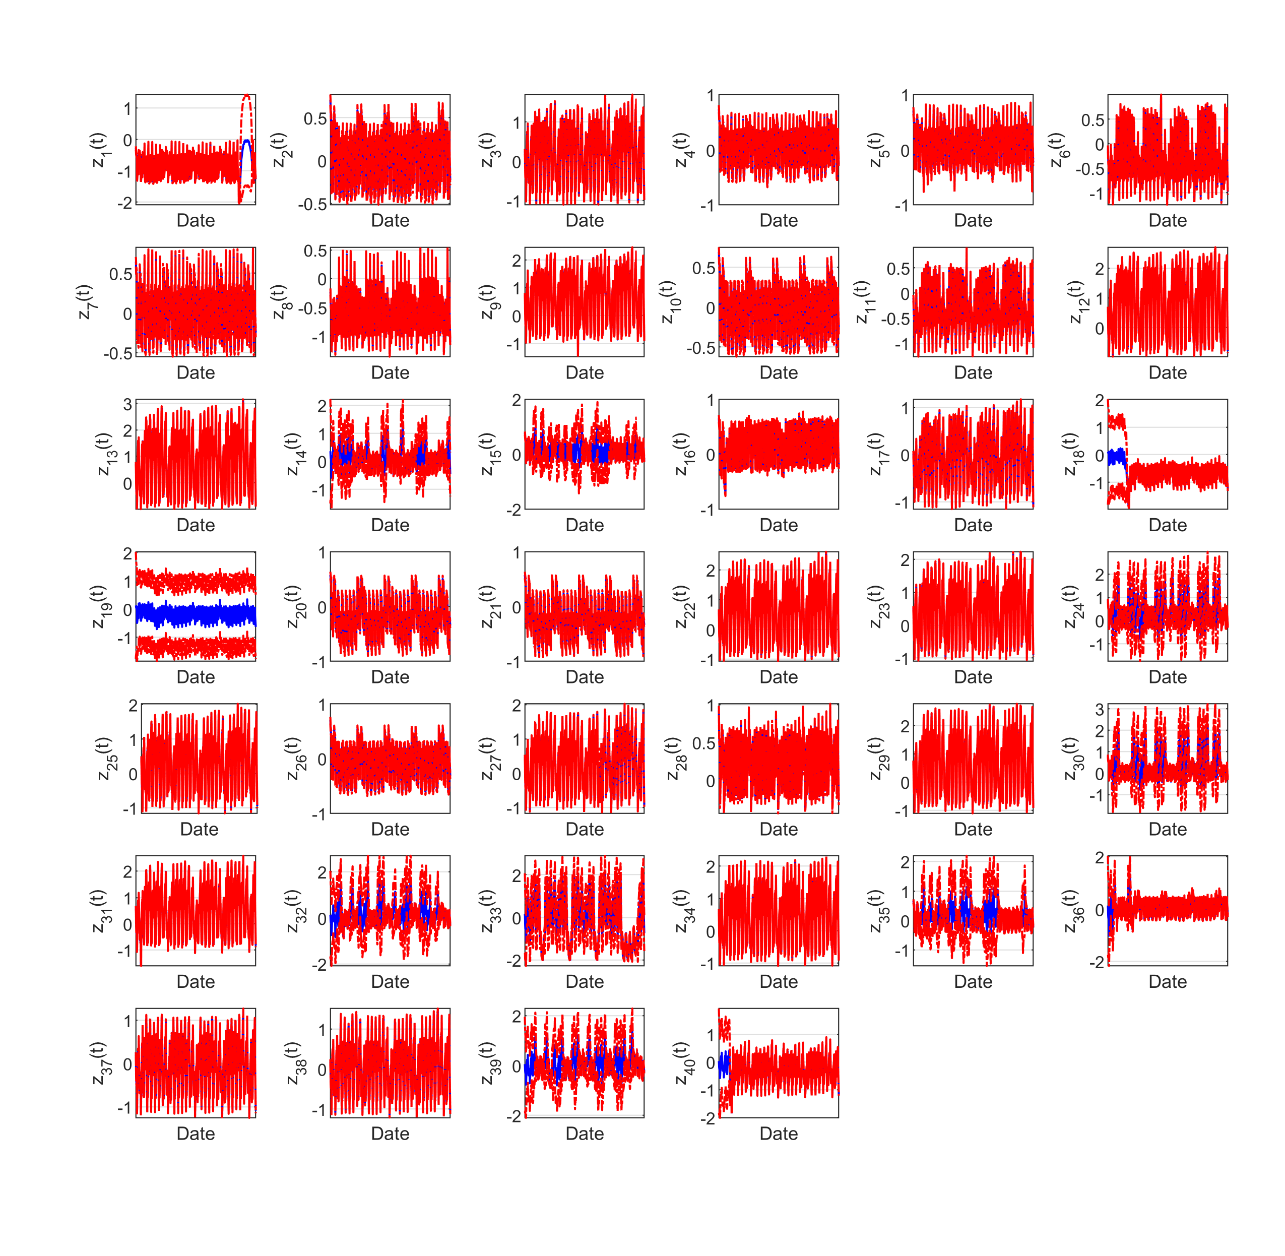
Latent variable
Each station has a latent variable with markovian dynamics
Most latent variables exhibit similar temporal patterns, instead some portrays distinct behaviors
Potential heterogeneity across space or conditions
Model fails to capture all the variability within the traffic data
Figure 12: Latent variables estimated by the HDGM and their temporal behaviour per each station

Slide 28
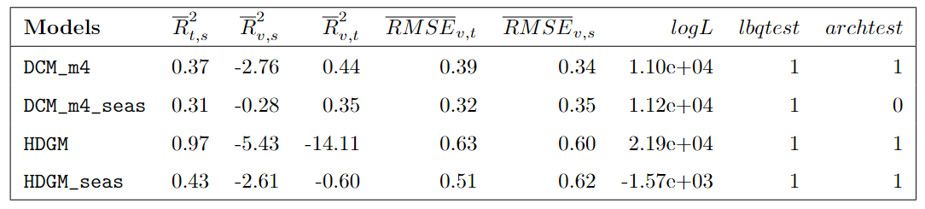
Conclusions
The traffic phenomenon is highly complex
DCM and HDGM performances are low
Theorical limitations or wrong enrichment ?
Differencing method is worth the try
DCM_m4_seas emerges as a more performant mode to apply to this specific case study
Table 6: Goodness statistics per each model analyzed, along with their residual tests

Slide 29
Further research
The traffic phenomenon is highly complex

Slide 30
References
[1] John Young Sorensen. Salt lake city traffic. https://www.kaggle.com/datasets/johnyoungsorensen/salt-lake-city-traffic, 2022.
[2] Open-Meteo. Meteorological forecast service. https://www.open-meteo.com, 2024.
[3] Francesco Finazzi and Alessandro Fassò. D-stem: A software for the analysis and mapping of environmental space-time variables. Journal of Statistical Software, 62, 12 2014. doi: 10.18637/jss.v062.i06.
[4] Yaqiong Wang, Francesco Finazzi, and Alessandro Fass`o. D-stem v2: A software for modeling functional spatio-temporal data. Journal of Statistical Software, 99(10):1–29, 2021. doi: 10.18637/jss.v099.i10. URL https://www.jstatsoft.org/index.php/jss/article/view/v099i10.
[5] Rob J Hyndman and George Athanasopoulos. Forecasting: principles and practice. OTexts, 2018.

